Slide 1
COMC Preparation

Slide 2
Overview:
Date: November 8, 2018
Time: 8:30am
Location: Library
No calculators
2.5 hours long
3 parts: A) Easy (4 x 4pt) B) Thinking Questions (4 x 6pt) C) Challenging (4 x 10pt) Total Points 80
Things to Bring: Scrap paper, two pencils, eraser, protractor, compass, grid paper, (lead, ruler,
Goal: minimum 60 points

Slide 3
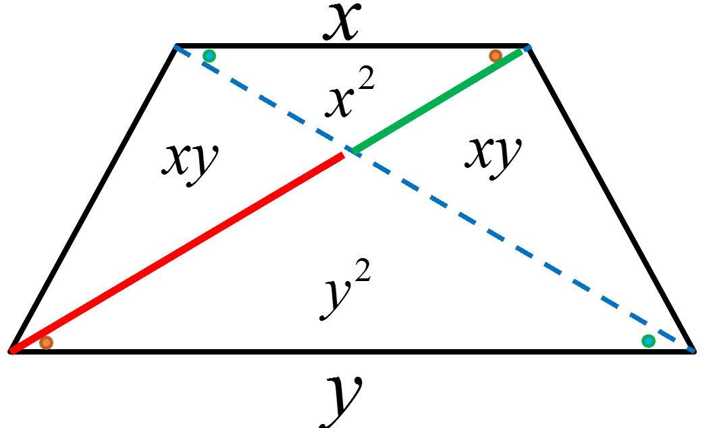
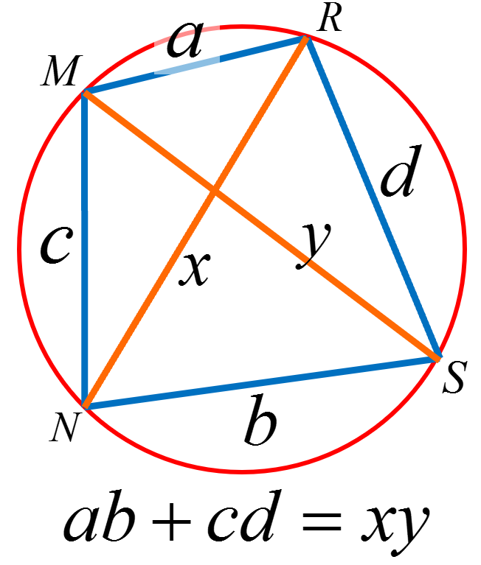
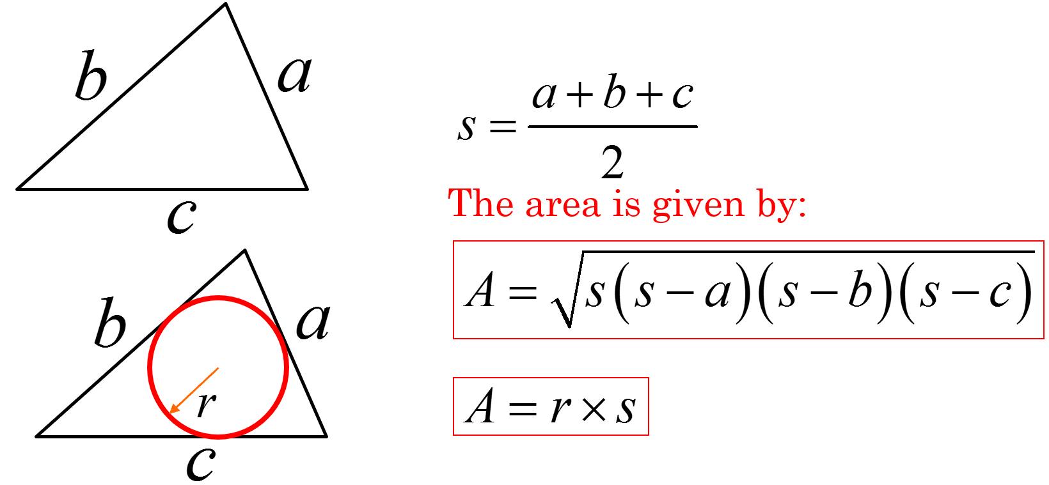
Things to Remember:
Trig Identities:
Similar triangles
Factoring:
Geometry:
Probability

Slide 4
Time Management:
Pace yourself:
Part A: Don’t Rush, read each question carefully,
Low thinking questions, little skills, don’t overthink
Check it once, be careful, don’t make mistakes
You don’t need to show your work BUT – you should try to write things down so that it’s easier to check your work
If your answer is correct – full marks, if incorrect, work shown will provide part marks
Part B: Bit more challenging, 4 questions → 3 easy & 1 hard
Do the easy ones first,
Spend two minutes to read the hard one and then come back to it later, write down your ideas
You don’t need to show your work BUT – you should try to write things down so that it’s easier to check your work
If your answer is correct – full marks, if incorrect, work shown will provide part marks

Slide 5
Part C: Each question has parts a, b, and c → Do the first two parts of each question, come back to the last part
In the 3rd part of every part “C” question, try to use the first two questions as hints!
You need to show all your work and steps to earn full marks
Partial marks will be awarded if part of the work is shown
Write NEATLY!! Easier to give marks

Slide 6
How to start Difficult Questions:
For each part 3 question in Part “C”, look at the previous two questions for ideas and hints
Use i) and ii) as hints, SO DON’T jump straight to part “C”

